Slide 1

Classification of Audio from Musical Instruments

Slide 2
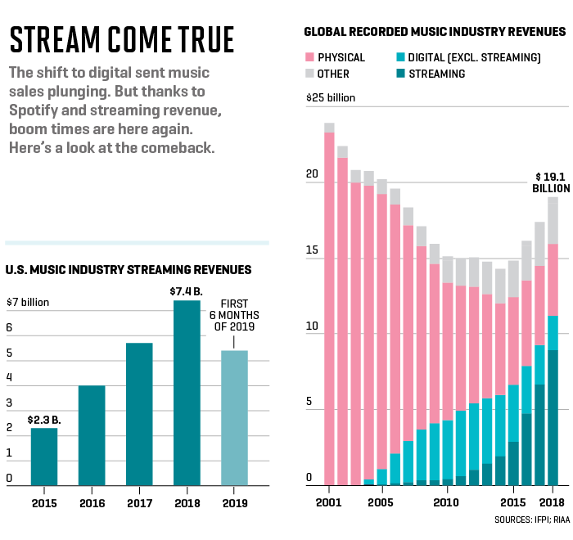
Problem Statement
Objective
To predict source of sound from a class of 10 different music instruments. The class of instruments are 'Acoustic_guitar', 'Bass_drum','Cello','Clarinet','Double_bass','Flute',’Hi hat’, 'Saxophone’, 'Snare_drum’ and 'Violin’
Purpose
Eg: Help Youtube/Spotify users to select correctly tagged music of their interest with specific music instruments
Notes:
Audio classification is an active area of research and implementation in today’s world. Emerging devices like Amazon Alexa, Google Home try to capture distinct parts of audio and try to understand the meaning behind it to respond appropriately to help the user.
This project only scratches the surface of this vast space.

Slide 3

Methodology
Build CNN
Measure Validation
Accuracy
Check Ensemble
Data Visualization
Down
Sampling
Audio Transformation
Accuracy Comparison
Build RNN
Measure
Validation
Accuracy

Slide 4
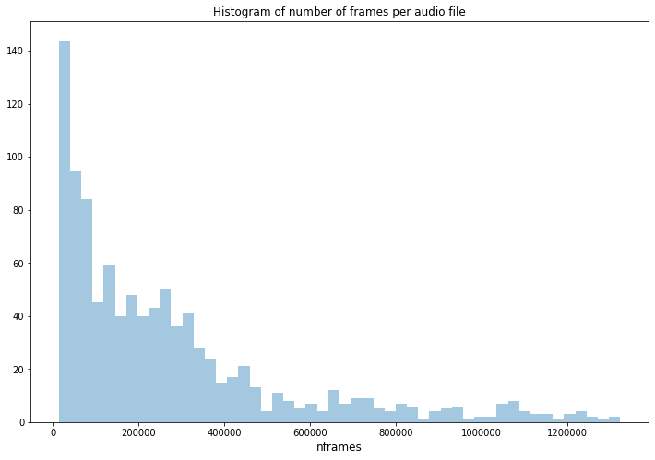
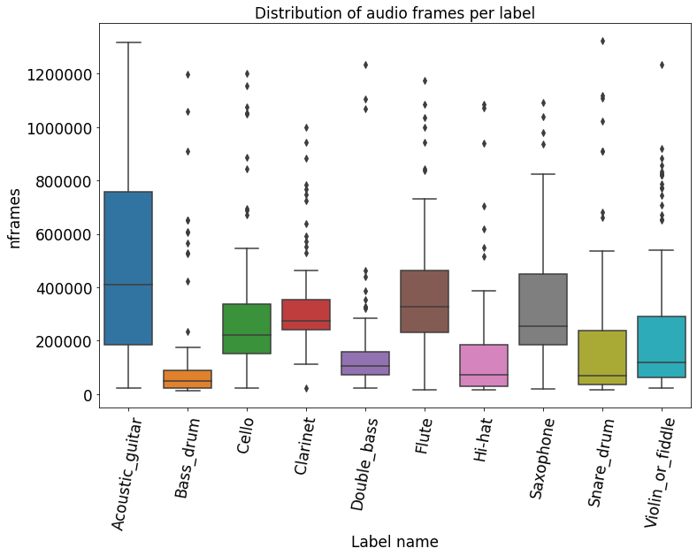
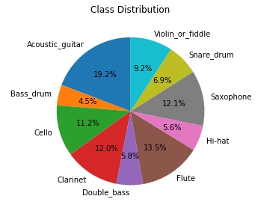
Understanding the Dataset

Slide 5
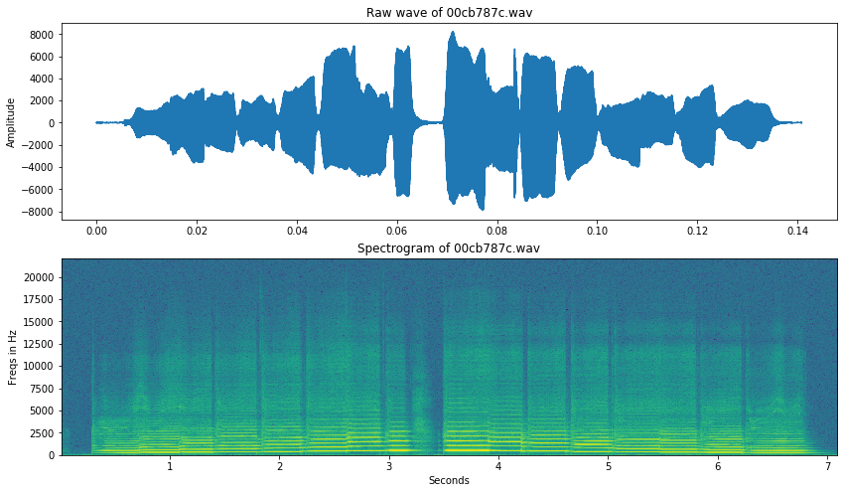

Understanding an Audio Signal
00cb787c.wav | Flute

Slide 6
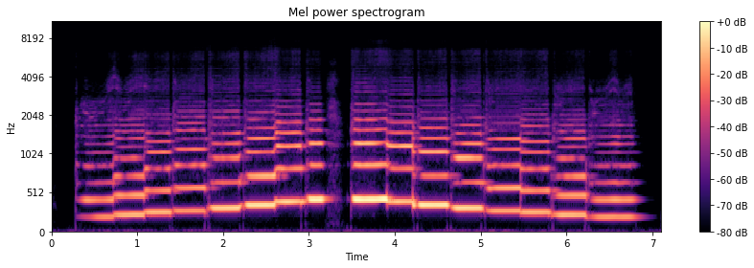
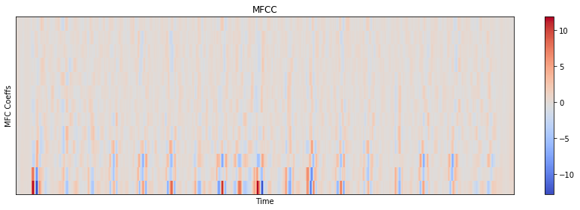
Understanding an Audio Signal
00cb787c.wav | Flute

Slide 7
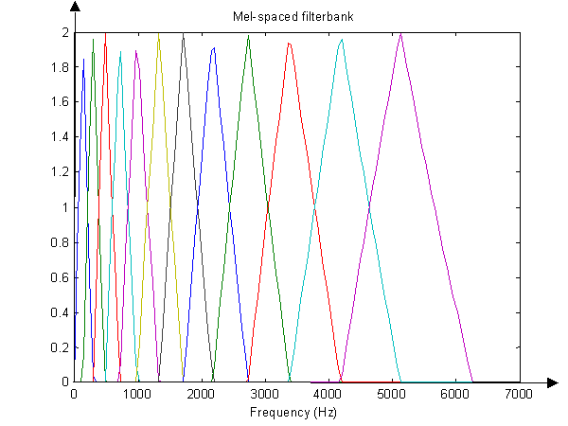
Transformation Process
Audio.wav
Compute signal energy through Filterbank
Read amplitudes & intensity into an array
Retrieve Mel Frequency Cepstrum Coefficients
Split audio into frames of 10 ms
Use these as inputs to model
Do Fourier Transform on each frame of the signal

Slide 8
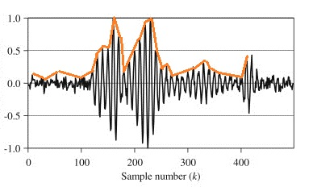
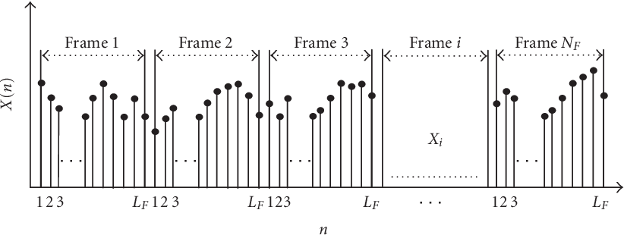
Preparing Dataset
Remove files less than 20 kb
Remove dead space based on threshold = 0.0005 from the envelope
Split into 10 ms Frames

Slide 9
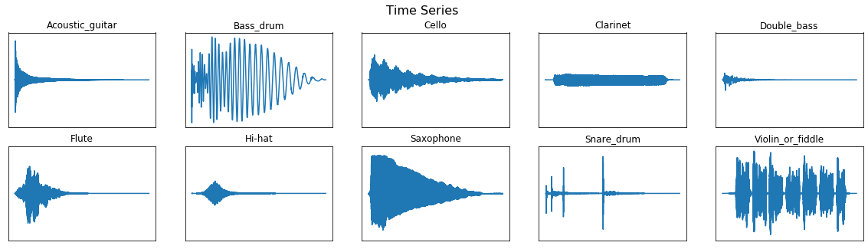
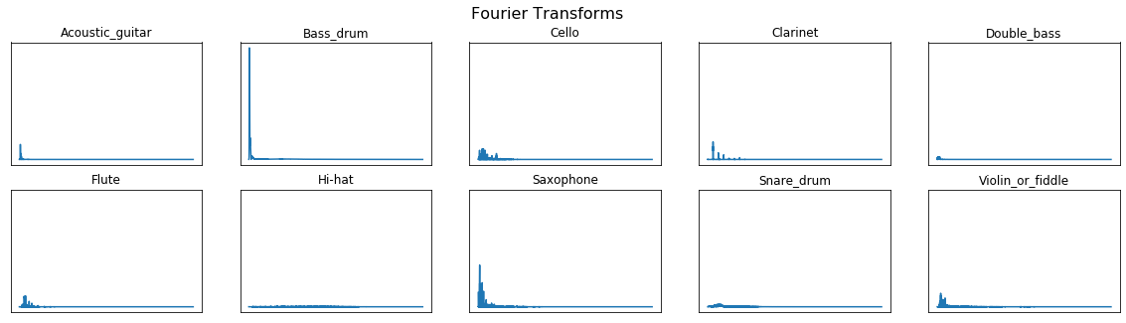
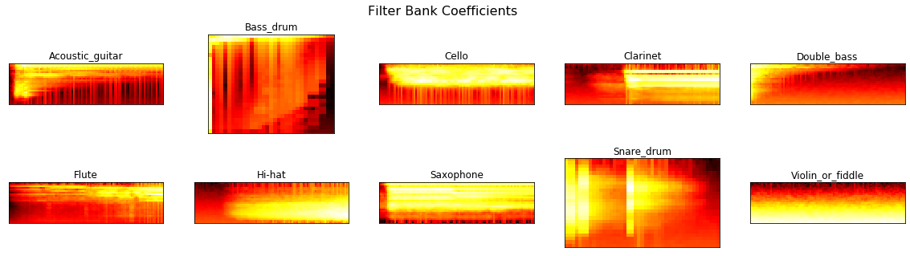
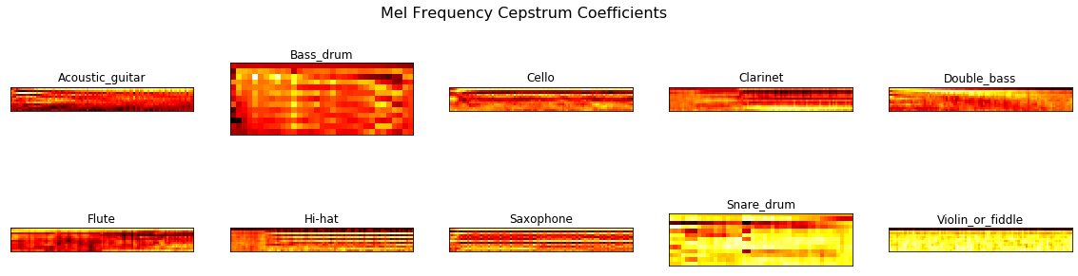
Audio Transformation Illustration
2
1
3
4

Slide 10
CNN Architecture
_________________________________________________________________
Layer (type) Output Shape Param #
=================================================================
conv2d_13 (Conv2D) (None, 9, 13, 16) 160
_________________________________________________________________
conv2d_14 (Conv2D) (None, 9, 13, 32) 4640
_________________________________________________________________
conv2d_15 (Conv2D) (None, 9, 13, 64) 18496
_________________________________________________________________
conv2d_16 (Conv2D) (None, 9, 13, 128) 73856
_________________________________________________________________
conv2d_17 (Conv2D) (None, 9, 13, 256) 295168
_________________________________________________________________
dropout_4 (Dropout) (None, 9, 13, 256) 0
_________________________________________________________________
max_pooling2d_3 (MaxPooling2 (None, 4, 6, 256) 0
_________________________________________________________________
dropout_5 (Dropout) (None, 4, 6, 256) 0
_________________________________________________________________
flatten_3 (Flatten) (None, 6144) 0
_________________________________________________________________
dense_9 (Dense) (None, 256) 1573120
_________________________________________________________________
dense_10 (Dense) (None, 128) 32896
_________________________________________________________________
dense_11 (Dense) (None, 64) 8256
_________________________________________________________________
dense_12 (Dense) (None, 10) 650
=================================================================
Total params: 2,007,242
Trainable params: 2,007,242
Non-trainable params: 0
Layer (type) Output Shape Param #
=================================================================
conv2d_21 (Conv2D) (None, 9, 13, 16) 160
_________________________________________________________________
conv2d_22 (Conv2D) (None, 9, 13, 32) 4640
_________________________________________________________________
conv2d_23 (Conv2D) (None, 9, 13, 64) 18496
_________________________________________________________________
conv2d_24 (Conv2D) (None, 9, 13, 128) 73856
_________________________________________________________________
max_pooling2d_6 (MaxPooling2 (None, 4, 6, 128) 0
_________________________________________________________________
dropout_15 (Dropout) (None, 4, 6, 128) 0
_________________________________________________________________
flatten_15 (Flatten) (None, 3072) 0
_________________________________________________________________
dense_61 (Dense) (None, 128) 393344
_________________________________________________________________
dense_62 (Dense) (None, 64) 8256
_________________________________________________________________
dense_63 (Dense) (None, 10) 650
=================================================================
Total params: 499,402
Trainable params: 499,402
Non-trainable params: 0

Slide 11
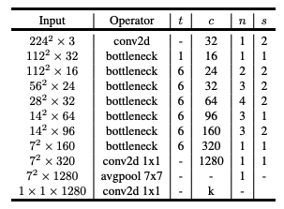
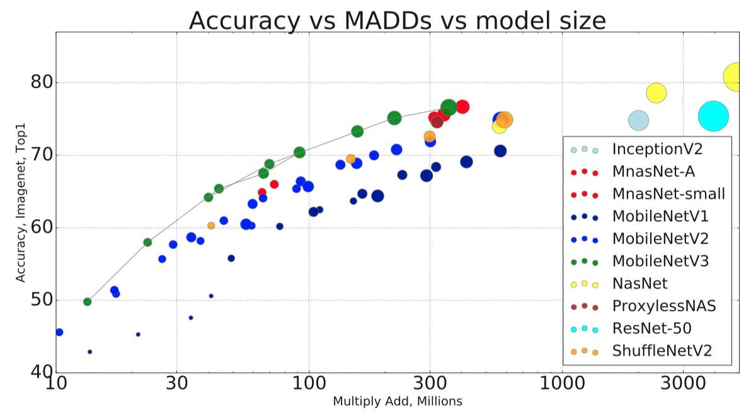
CNN MobileNetv2 Architecture

Slide 12
RNN Architecture
_________________________________________________________________
Layer (type) Output Shape Param #
=================================================================
lstm_23 (LSTM) (None, 9, 128) 72704
_________________________________________________________________
lstm_24 (LSTM) (None, 9, 128) 131584
_________________________________________________________________
dropout_17 (Dropout) (None, 9, 128) 0
_________________________________________________________________
time_distributed_41 (TimeDis (None, 9, 64) 8256
_________________________________________________________________
time_distributed_42 (TimeDis (None, 9, 32) 2080
_________________________________________________________________
time_distributed_43 (TimeDis (None, 9, 16) 528
_________________________________________________________________
time_distributed_44 (TimeDis (None, 9, 8) 136
_________________________________________________________________
flatten_17 (Flatten) (None, 72) 0
_________________________________________________________________
dense_73 (Dense) (None, 10) 730
=================================================================
Total params: 216,018
Trainable params: 216,018
Non-trainable params: 0

Slide 13
Performance Summary
Train Dataset | Test Dataset | CNN Train Accuracy with 10% Val | CNN Test Accuracy | RNN Train Accuracy with 10% Val | RNN Test Accuracy | Action
1312 | 1688 | 94.5% | 44.5% | 88.3% | 41.1% | Epochs =10
1000 | 1000 | 92.5% | 58.5% | 84.7% | 54.8% | Data Vol Chg
2000 | 1000 | 88.3% | 60.7% | 75.6% | 56.6% | Data Vol Chg, With L2, Dropout
2000 | 1000 | 95.9% | 57.3% | -- | -- | Epochs = 25, With L2, Dropout
2000 | 1000 | 92.5% | 62% | -- | -- | Epochs = 10, Additional layers, With L2, Dropout
2000 (1 GB) | 1000 | 95% | 65.5% | -- | -- | Using MobileNetv2 With L2, Dropout

Slide 14
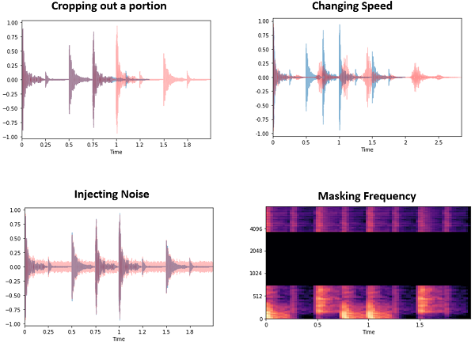
Future Improvements
Data Augmentation (Active area of research by Google Brain, July 2019)
Noise Injection
Shifting Time
Changing Pitch
Changing Speed
Use transfer learning
May use Hyperas for hyper parameter tuning but could be expensive
Gather more labelled audio files
Use spectrogram images instead of MFC coefficients or both

Slide 15
References
[1] Mark Sandler, Andrew Howard, Menglong Zhu, Andrey Zhmoginov, Liang-Chieh Chen, MobileNetV2: Inverted Residuals and Linear , 2018
Source: arXiv:1801.04381
[2] Freesound General-Purpose Audio Tagging Challenge, Kaggle.com
[3] Daniel S. Park et. al. Google Brain, SpecAugment: A Simple Data Augmentation Method for Automatic Speech Recognition, 2019
Source: arXiv:1904.08779

Slide 16

Questions?

